Slide 1
NoSQL Databases (18CS823): Document Databases (Module 4)
Presenter:
Mrs. Ancy Thomas
Assistant Professor
Department of Computer Science and Engineering
Acharya Institute of Technology

Slide 2
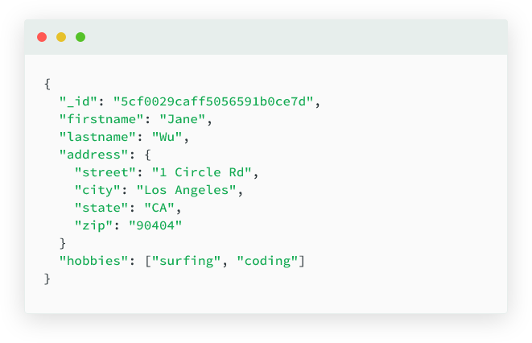
Document Databases
A document database (also known as a document-oriented database or a document store) is a database that stores information in documents.

Slide 3
Document databases offer a variety of advantages, including:
An intuitive data model that is fast and easy for developers to work with.
A flexible schema that allows for the data model to evolve as application needs change.
The ability to horizontally scale out.
Some of the popular document databases are
MongoDB
CouchDB
Terrastore
OrientDB
RavenDB
Lotus Notes

Slide 4
What are documents?
A document is a record in a document database. A document typically stores information about one object and any of its related metadata.
Documents store data in field-value pairs.
The values can be a variety of types and structures, including strings, numbers, dates, arrays, or objects.
Documents can be stored in formats like JSON, BSON, and XML.

Slide 5
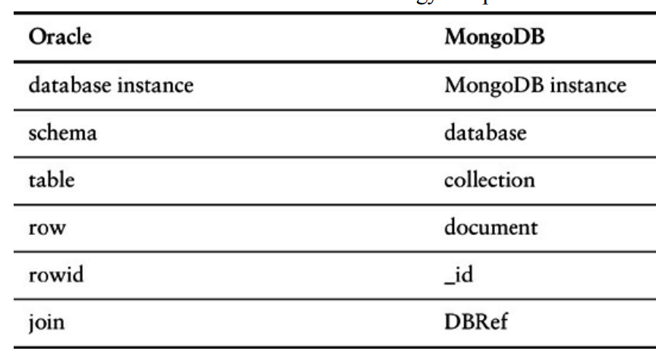
Terminology comparison in Oracle and MongoDB

Slide 6
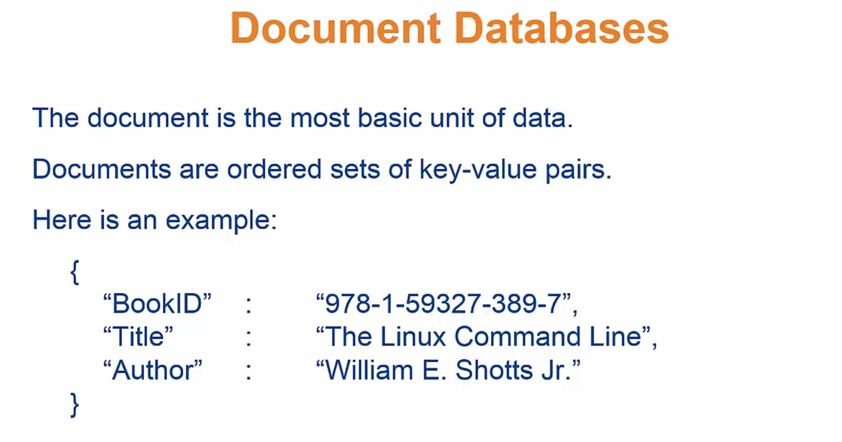

Slide 7
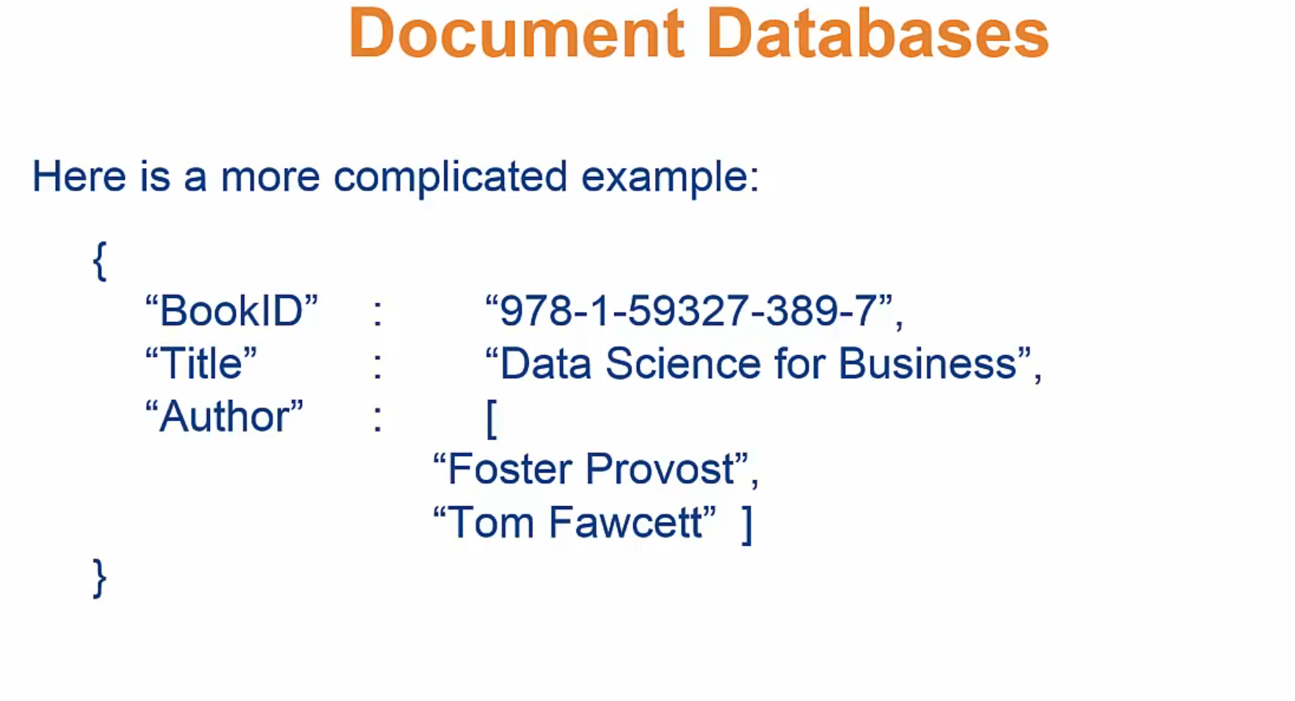

Slide 8
Example
Document2:
{
"firstname": "Pramod",
"citiesvisited": [ "Chicago", "London", "Pune", "Bangalore" ],
"addresses": [
{ "state": "AK",
"city": "DILLINGHAM",
"type": "R"
},
{ "state": "MH",
"city": "PUNE",
"type": "R" }
],
"lastcity": "Chicago"
}
Documen1:
{ "firstname": "Martin",
"likes": [ "Biking",
"Photography" ],
"lastcity": "Boston",
"lastVisited":
}

Slide 9
Below is a JSON document that stores information about a user named Tom.
{
"_id": 1,
"first_name": "Tom",
"email": "tom@example.com",
"cell": "765-555-5555",
"likes": [
"fashion",
"spas",
"shopping"
],
"businesses": [
{
"name": "Entertainment 1080",
"partner": "Jean",
"status": "Bankrupt",
"date_founded": {
"$date": "2012-05-19T04:00:00Z"
}
},
{
"name": "Swag for Tweens",
"date_founded": {
"$date": "2012-11-01T04:00:00Z"
}
}
]
}

Slide 10
Collections
A collection is a group of documents.
Collections typically store documents that have similar contents.
Not all documents in a collection are required to have the same fields, because document databases have a flexible schema.
Note that some document databases provide schema validation, so the schema can optionally be locked down when needed.

Slide 11
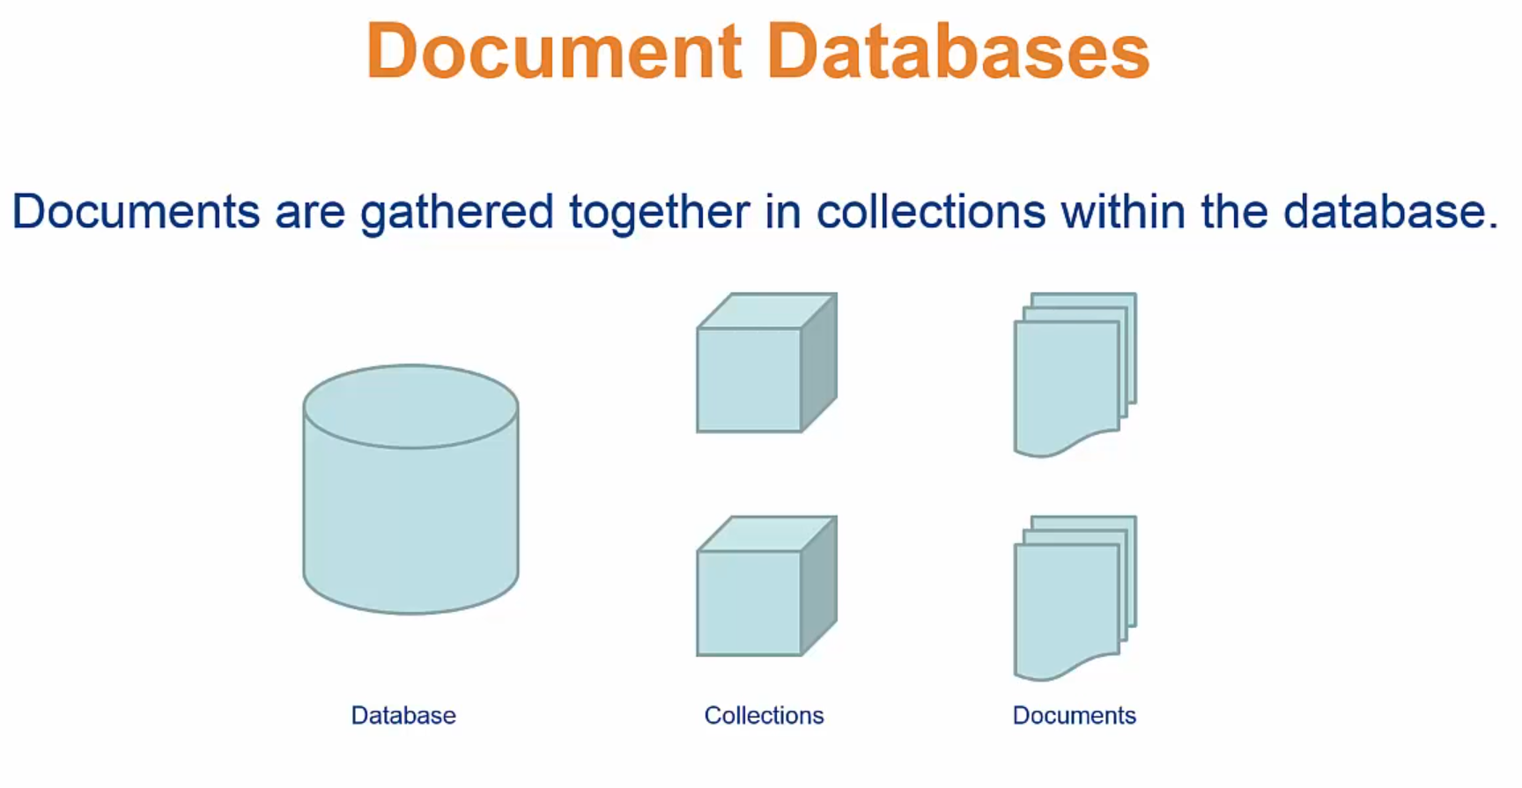

Slide 12
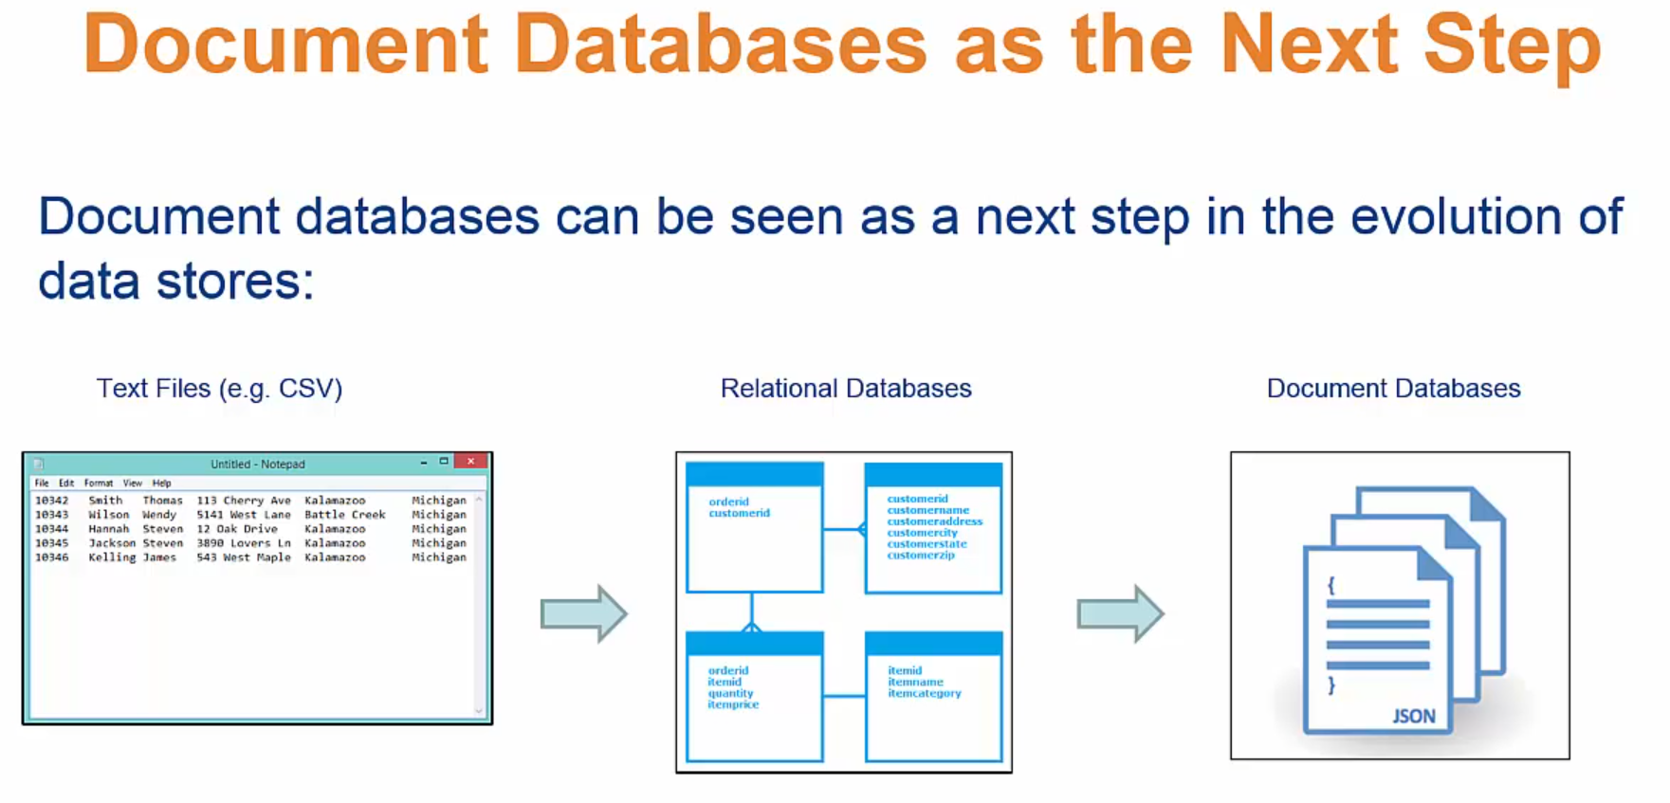

Slide 13
Continuing with the example Slide 5, the document with information about Tom could be stored in a collection named users.
More documents could be added to the users collection in order to store information about other users.
For example, the document below that stores information about Donna could be added to the users collection.
{
"_id": 2,
"first_name": "Donna",
"email": "donna@example.com",
"spouse": "Joe",
"likes": [
"spas",
"shopping",
"live tweeting"
],
"businesses": [
{
"name": "Castle Realty",
"status": "Thriving",
"date_founded": {
"$date": "2013-11-21T04:00:00Z"
}
}
]
}

Slide 14
CRUD operations
Document databases typically have an API or query language that allows developers to execute the CRUD (create, read, update, and delete) operations.
Create: Documents can be created in the database. Each document has a unique identifier.
Read: Documents can be read from the database. The API or query language allows developers to query for documents using their unique identifiers or field values. Indexes can be added to the database in order to increase read performance.
Update: Existing documents can be updated — either in whole or in part.
Delete: Documents can be deleted from the database.

Slide 15
Key features of document databases
Document databases have the following key features:
Document model: Data is stored in documents (unlike other databases that store data in structures like tables or graphs). Documents map to objects in most popular programming languages, which allows developers to rapidly develop their applications.
Flexible schema: Document databases have a flexible schema, meaning that not all documents in a collection need to have the same fields. Note that some document databases support schema validation, so the schema can be optionally locked down.
Distributed and resilient: Document databases are distributed, which allows for horizontal scaling (typically cheaper than vertical scaling) and data distribution. Document databases provide resiliency through replication.
Querying through an API or query language: Document databases have an API or query language that allows developers to execute the CRUD operations on the database. Developers have the ability to query for documents based on unique identifiers or field values.

Slide 16
Features
Consistency
Transactions
Availability
Query Features
Scaling

Slide 17
How MongoDB works
Each MongoDB instance has multiple databases, and each database can have multiple collections.
When we compare this with RDBMS,
an RDBMS instance is the same as MongoDB instance,
the schemas in RDBMS are similar to MongoDB databases, and
the RDBMS tables are collections in MongoDB.
When we store a document, we have to choose which database and collection this document belongs in—for example,
database.collection.insert(document), which is usually represented as
db.coll.insert(document).

Slide 18
Consistency
Consistency in MongoDB database is configured by using the replica sets
A command - db.runCommand({ getlasterror : 1 , w : "majority" })
Replica sets also allow you to increase the read performance by allowing reading from slaves by setting slaveOk; this parameter can be set on the connection, or database, or collection, or individually for each operation.
Mongo mongo = new Mongo("localhost:27017");
mongo.slaveOk();

Slide 19
Here we are setting slaveOk per operation, so that we can decide which operations can work with data from the slave node.
DBCollection collection = getOrderCollection();
BasicDBObject query = new BasicDBObject();
query.put("name", "Martin");
DBCursor cursor = collection.find(query).slaveOk();

Slide 20
Transaction
In RDBMS sense - insert, update, or delete commands
commit or rollback
These constructs are generally not available in NoSQL solutions—a write either succeeds or fails.
Transactions at the single-document level are known as atomic transactions.
Transactions involving more than one operation are not possible, although there are products such as RavenDB that do support transactions across multiple operations

Slide 21
Transaction
We ensure that order is written to more than one node before it’s reported successful by using WriteConcern.REPLICAS_SAFE.
Different levels of WriteConcern let you choose the safety level during writes; for example, when writing log entries, you can use lowest level of safety, WriteConcern.NONE.
final Mongo mongo = new Mongo(mongoURI); mongo.setWriteConcern(REPLICAS_SAFE);
DBCollection shopping = mongo.getDB(orderDatabase)
.getCollection(shoppingCollection);
try {
WriteResult result = shopping.insert(order, REPLICAS_SAFE);
//Writes made it to primary and at least one secondary
} catch (MongoException writeException) {
//Writes did not make it to minimum of two nodes including primary
dealWithWriteFailure(order, writeException);
}

Slide 22
Availability
Document databases try to improve on availability by replicating data using the master-slave setup.
The same data is available on multiple nodes and the clients can get to the data even when the primary node is down.
Usually, the application code does not have to determine if the primary node is available or not.
MongoDB implements replication, providing high availability using replica sets.

Slide 23
Availability
In a replica set, there are two or more nodes participating in an asynchronous master-slave replication.
The replica-set nodes elect the master, or primary, among themselves.
Assuming all the nodes have equal voting rights, some nodes can be favored for being closer to the other servers, for having more RAM, and so on; users can affect this by assigning a priority—a number between 0 and 1000—to a node.
All requests go to the master node, and the data is replicated to the slave nodes.
If the master node goes down, the remaining nodes in the replica set vote among themselves to elect a new master; all future requests are routed to the new master, and the slave nodes start getting data from the new master.
When the node that failed comes back online, it joins in as a slave and catches up with the rest of the nodes by pulling all the data it needs to get current.

Slide 24
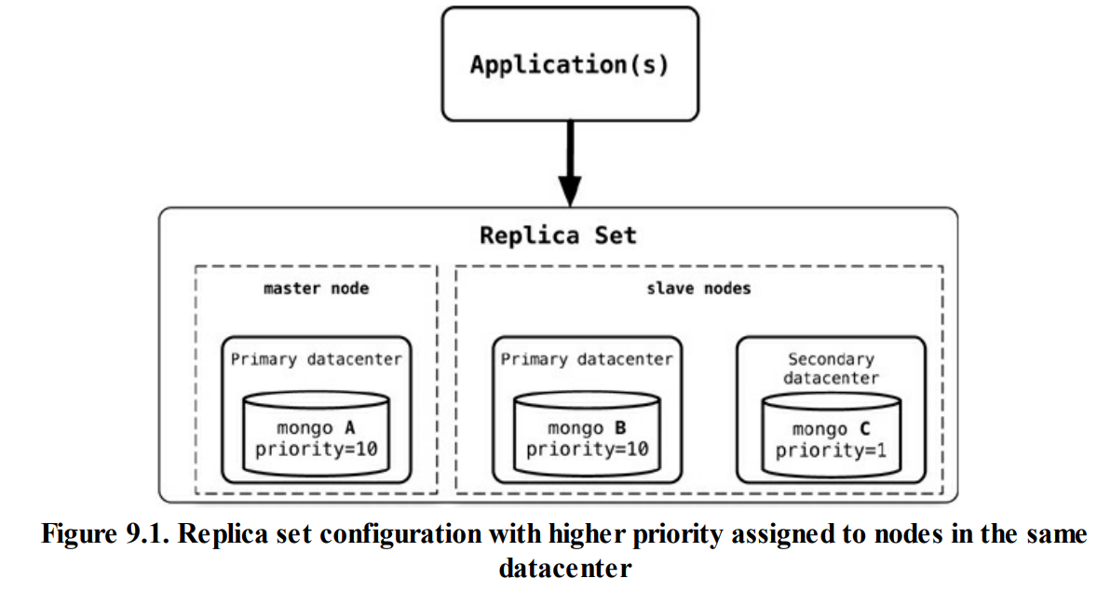
Availability

Slide 25
Availability
The application writes or reads from the primary (master) node.
When connection is established, the application only needs to connect to one node (primary or not, does not matter) in the replica set, and the rest of the nodes are discovered automatically.
When the primary node goes down, the driver talks to the new primary elected by the replica set.
The application does not have to manage any of the communication failures or node selection criteria.
Using replica sets gives you the ability to have a highly available document data store.
Replica sets are generally used for data redundancy, automated failover, read scaling, server maintenance without downtime, and disaster recovery.
Similar availability setups can be achieved with CouchDB, RavenDB, Terrastore, and other products.

Slide 26
Query Features
Document databases provide different query features.
CouchDB allows you to query via views— complex queries on documents which can be either materialized or dynamic.
With CouchDB, if you need to aggregate the number of reviews for a product as well as the average rating, you could add a view implemented via map-reduce to return the count of reviews and the average of their ratings.
When there are many requests, that no need to compute the count and average for every request; instead can add a materialized view that precomputes the values and stores the results in the database.
These materialized views are updated when queried, if any data was changed since the last update.

Slide 27
Query Features
One of the good features of document databases, as compared to key-value stores, is that we can query the data inside the document without having to retrieve the whole document by its key and then introspect the document.
This feature brings these databases closer to the RDBMS query model.
MongoDB has a query language which is expressed via JSON and has constructs such as
$query for the where clause,
$orderby for sorting the data, or
$explain to show the execution plan of the query.
There are many more constructs like these that can be combined to create a MongoDB query.

Slide 28
Suppose we want to return all the documents in an order collection (all rows in the order table). The SQL for this would be:
SELECT * FROM order;
The equivalent query in Mongo shell would be:
db.order.find()
Selecting the orders for a single customerId of 883c2c5b4e5b would be:
SELECT * FROM order WHERE customerId = "883c2c5b4e5b"
The equivalent query in Mongo to get all orders for a single customerId of 883c2c5b4e5b:
db.order.find({"customerId":"883c2c5b4e5b"})

Slide 29
selecting orderId and orderDate for one customer in SQL would be:
SELECT orderId,orderDate FROM order WHERE customerId = "883c2c5b4e5b“;
and the equivalent in Mongo would be: db.order.find({customerId:"883c2c5b4e5b"},{orderId:1,orderDate:1})
To query for all the orders where one of the items ordered has a name like Refactoring. The SQL for this requirement would be:
SELECT * FROM customerOrder, orderItem, product WHERE customerOrder.orderId = orderItem.customerOrderId AND orderItem.productId = product.productId AND product.name LIKE '%Refactoring%’;
and the equivalent Mongo query would be: db.orders.find({"items.product.name":/Refactoring/})
The query for MongoDB is simpler because the objects are embedded inside a single document and you can query based on the embedded child documents.

Slide 30
Scaling
The idea of scaling is to add nodes or change data storage without simply migrating the database to a bigger box
Scaling for heavy-read loads can be achieved by adding more read slaves, so that all the reads can be directed to the slaves.
Given a heavy-read application, with our 3-node replica-set cluster, we can add more read capacity to the cluster as the read load increases just by adding more slave nodes to the replica set to execute reads with the slaveOk flag as shown in Figure 9.2.
This is horizontal scaling for reads

Slide 31
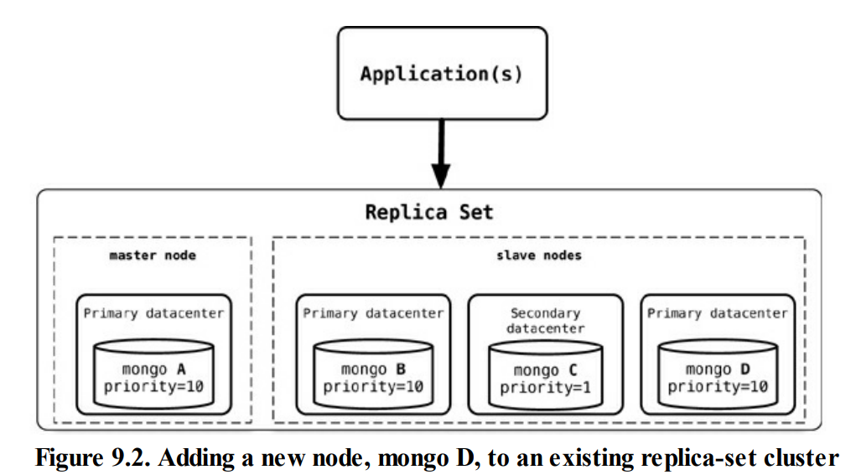
Scaling
Once the new node, mongo D, is started, it needs to be added to the replica set.
rs.add("mongod:27017");

Slide 32
Scaling
When a new node is added, it will sync up with the existing nodes, join the replica set as secondary node, and start serving read requests.
An advantage of this setup is that we do not have to restart any other nodes, and there is no downtime for the application either.
When we want to scale for write, we can start sharding the data.
In sharding, the data is also split by certain field, but then moved to different Mongo nodes.
The data is dynamically moved between nodes to ensure that shards are always balanced.
We can add more nodes to the cluster and increase the number of writable nodes, enabling horizontal scaling for writes

Slide 33
Splitting the data on the first name of the customer ensures that the data is balanced across the shards for optimal write performance; furthermore, each shard can be a replica set ensuring better read performance within the shard as shown in Figure 9.3.
When we add a new shard to this existing sharded cluster, the data will now be balanced across four shards instead of three.
As all this data movement and infrastructure refactoring is happening, the application will not experience any downtime, although the cluster may not perform optimally when large amounts of data are being moved to rebalance the shards

Slide 34
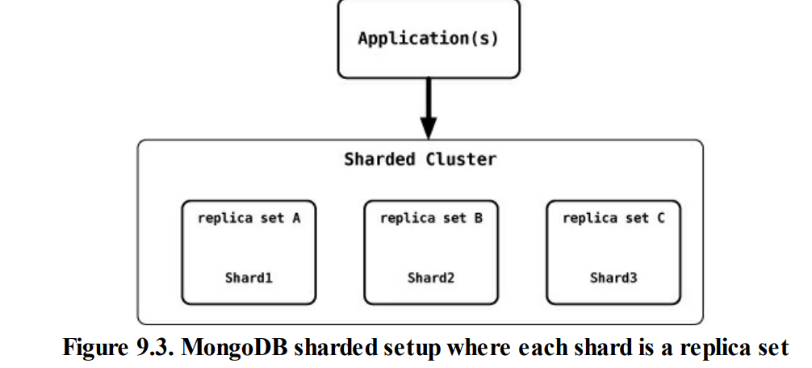

Slide 35
9.3. Suitable Use Cases
Event Logging
Content Management Systems, Blogging Platforms
Web Analytics or Real-Time Analytics (https://hevodata.com/learn/mongodb-real-time-analytics/)
E-Commerce Applications

Slide 36
https://www.mongodb.com/document-databases
https://www.mongodb.com/docs/manual/reference/log-messages/
https://www.youtube.com/watch?v=ZR_guYNLXQU
https://www.youtube.com/watch?v=OjUtXJ6vpKk
https://www.youtube.com/watch?v=o5rK7tJJ35U
https://www.youtube.com/watch?v=esKNjzDZItQ
https://www.youtube.com/watch?v=Up7dVFWW0kY
https://www.youtube.com/watch?v=pucvRpJVG_s
https://www.youtube.com/watch?v=F3TKNBEM4_M

